Slide 1

DESIGN AND IMPLEMENTATION OF TOUCHLESS ATTENDANCE SYSTEM
Researchers:
Darille B. Galleros
Jenesis R. Mouit
Mark Jade V. Banguis
Adviser: Jerry I. Teleron⁴

Slide 2
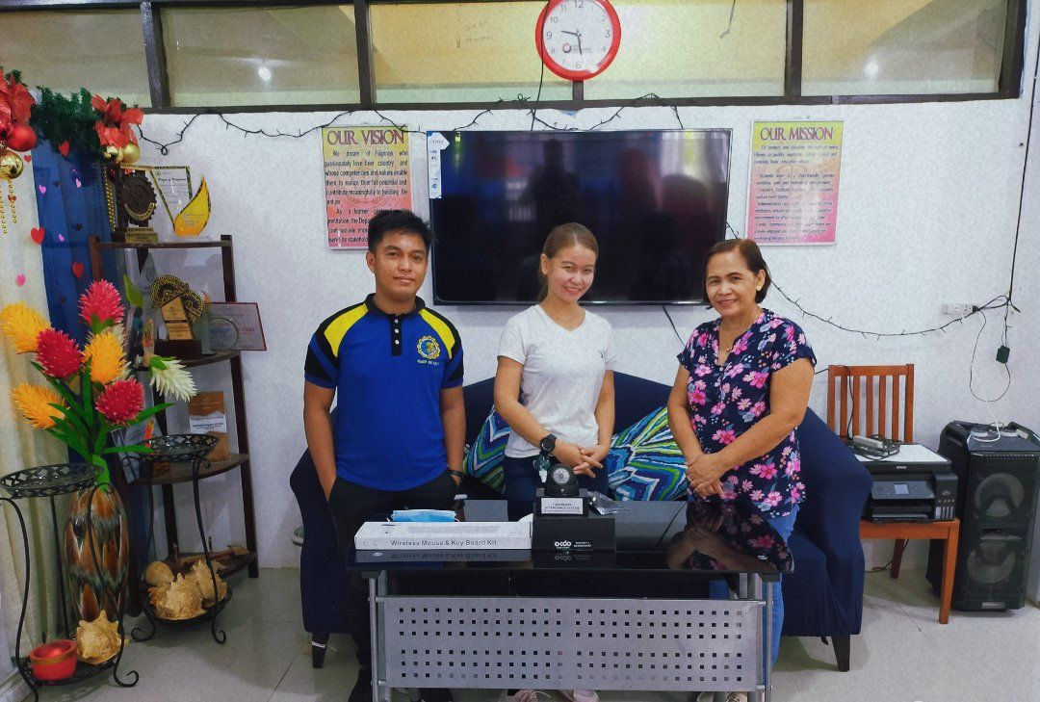
TARGET CLIENT / COMMUNITY
FG.1 target community: SURIGAO DEL NORTE NATIONAL HIGH SCHOOL

Slide 3
OBJECTIVES:
The ultimate objective of the study is to create a touch-less attendance system by face recognition with a temperature sensor in order to make it hassle-free for teachers to manually check the attendance for the students.
Specifically this study focused on the following:
Create a touch less attendance system by face recognition with a temperature sensor using python programming language.
Testing its usefulness and adaptability and flexibility.
To implement the project in SURIGAO DEL NORTE NATIONAL HIGH SCHOOL.

Slide 4
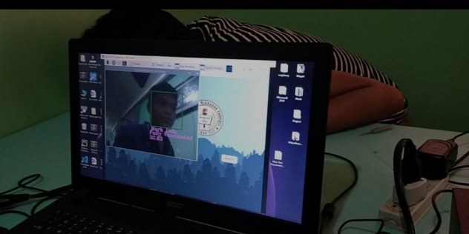
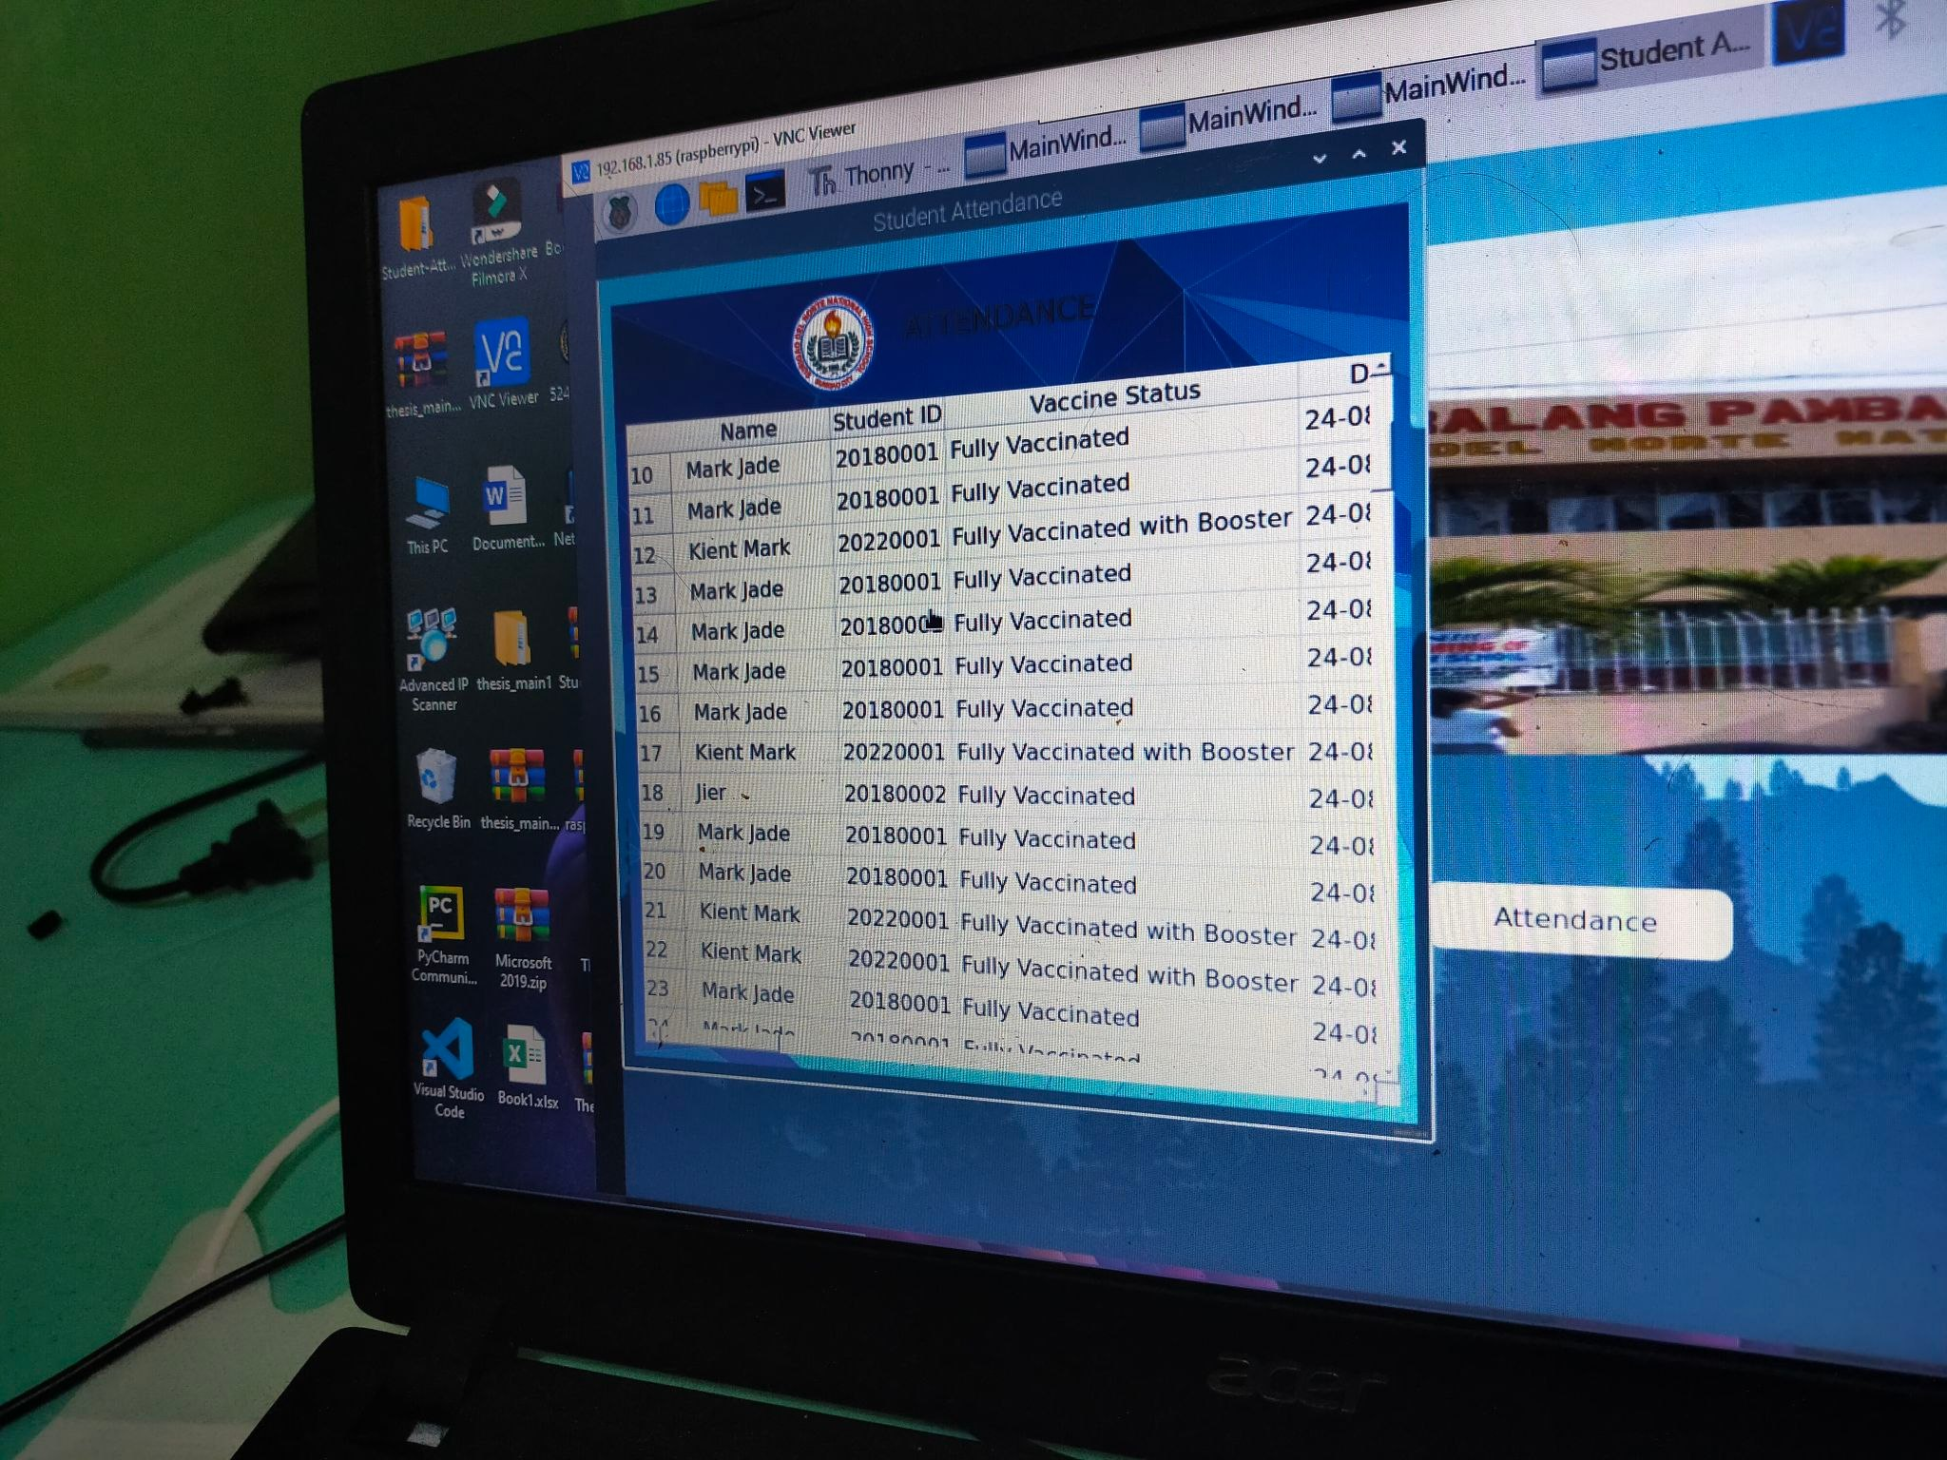
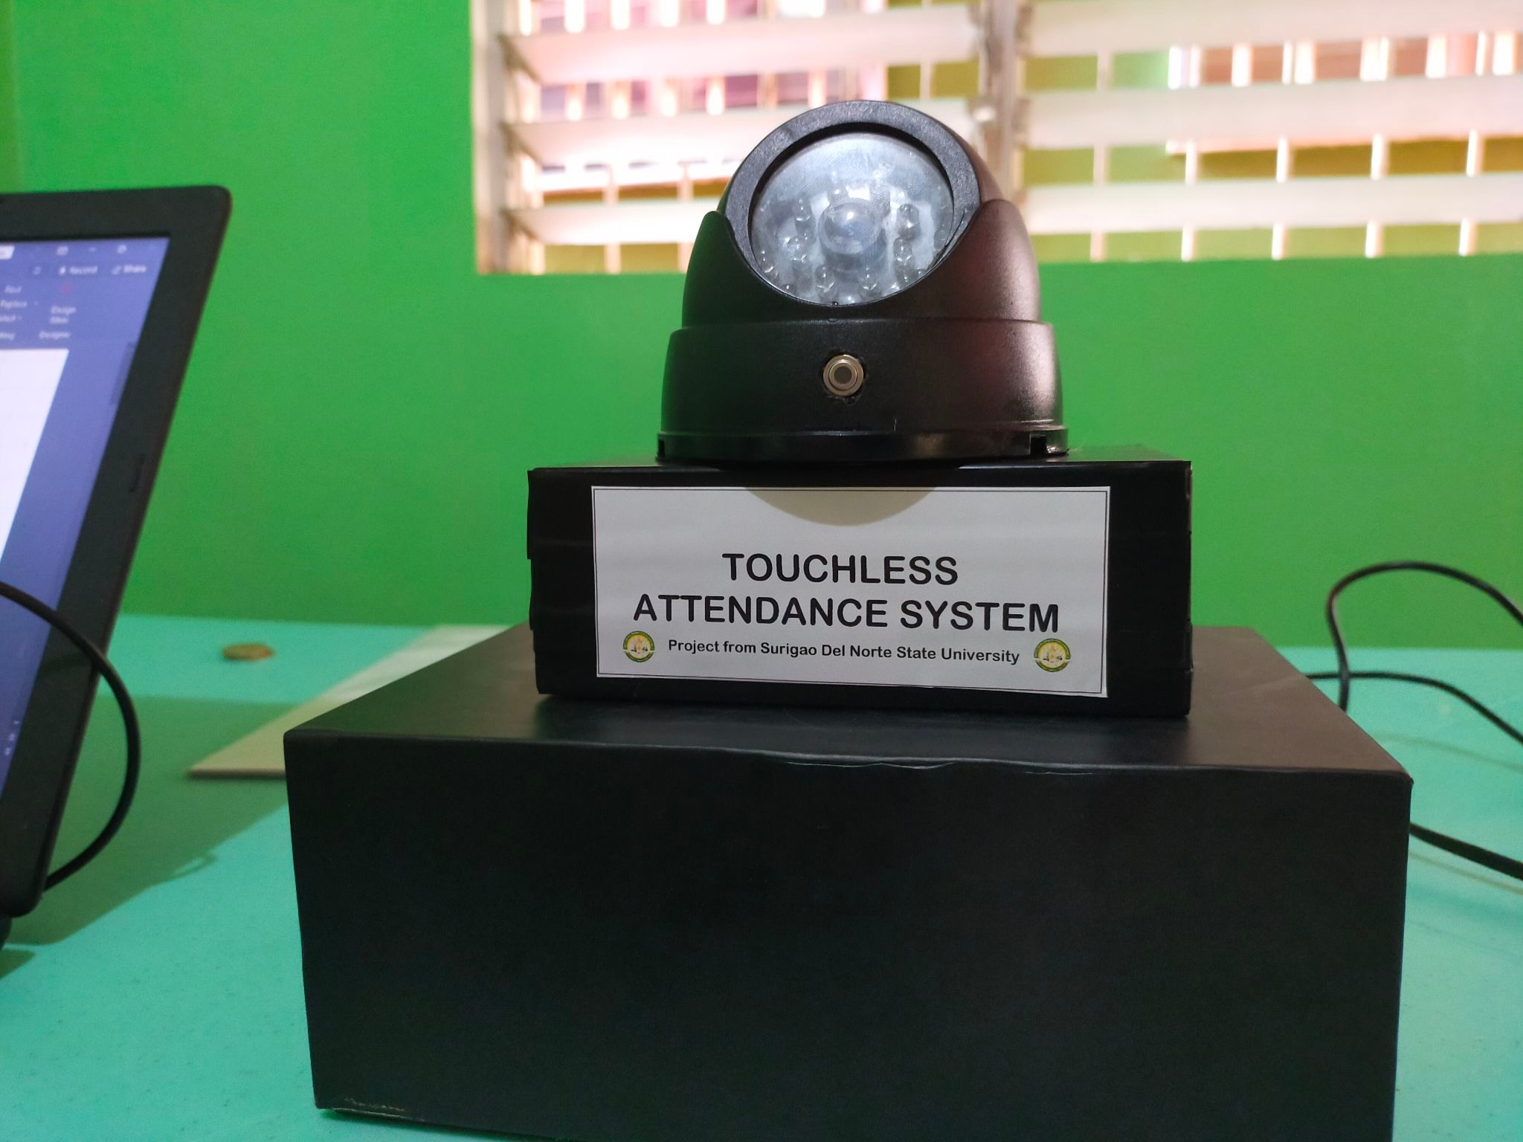
RESULTS AND DISSCUSSION
This chapter discusses all results presented in the research methodology. It showcases all results related to the objectives of the study and the process of making the output.
The researchers fully designed and fabricated a functional end-product that does all its features based on the first objective

Slide 5
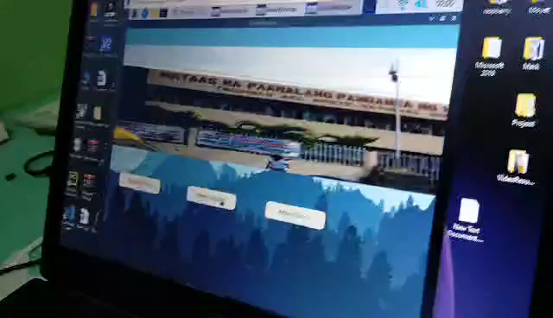

Slide 6
RECOMMENDATION
Since the developed project has limitations, the researchers recommend to the future researchers to redesign the system to be more flexible in terms of the following aspects:
The ability for the system to reset the GSM Module when no signal is detected and RC522 if it reaches the inactivity state.
Integrate a login-logout functionality to it and create a GUI using Tkinter for the registration part of the project instead of the CLI in the Thonny IDE.
Use a Raspberry Pi Touch Display instead of a computer monitor, a 3d outer design for better output quality, and a better computer or microcomputer as image processing requires a lot of memory resources.
Use a better or upgrade the hosting provider for both the Frontend desktop and a web application and the REST API instead of using a free tier plan.

